Slide 1

Canada Graduate Research Scholarship(CGRS)- Doctoral Application Workshop
Date: July 21st Time: 1:00-2:30 PM
Location: Zoom

Slide 2
Important Disclaimer
Recently, the Tricouncil Agencies (CIHR, NSERC, SSHRC) made numerous, significant changes to their doctoral funding award, formerly known as the Canada Graduate Scholarship-Doctoral (CGS-D)
The new harmonized award is now called the Canada Graduate Research Scholarship-Doctoral (CGRS-D)
Canadian universities are currently receiving updated information from the Tricouncils on this award; many pieces of information are unclear to date
If either the Tricouncils or Western’s SGPS provides information that differs from that presented here, please follow their instructions!!!!
Please consult with your graduate chair and SGPS on nuanced eligibility questions.

Slide 3
Canada Graduate Research Scholarship-Doctoral (CGRS-D)
Value: $40,000/year
Duration: 36 months
Results announced: April 30th, 2026

Slide 4
Eligibility
To be eligible to apply, you must have completed no more than 36 months of full-time equivalent study.
Eligibility for CGRS D is based on the number of months of full-time study, including summer months, you completed by December 31 of the calendar year of your application toward the degree for which you are requesting funding. Two terms of part-time study count as one term of full-time study.
Not have already received a doctoral-level scholarship or fellowship from CIHR, NSERC or SSHRC.
Up to 15% of awards will be available to international applicants.
The agencies count all studies toward the doctoral degree for which funding is requested, regardless of whether they were completed in the same program or at the same institution.

Slide 5
Eligibility – Subject Matter
There are three federal research councils:
Natural Sciences & Engineering Research Council (NSERC)
Canadian Institutes of Health Research (CIHR)
Social Sciences and Humanities Research Council (SSHRC)
You need to apply to the correct council which is determined by the subject matter of your research
If you are not sure, talk to a SGPS or the Social Science Research Office
No appeals based on subject matter
Notes:
Good to note here that different Faculties at Western get allocations for each Tricouncil. FSS gets a lot of SSHRCs, for ex. Almost all our students apply for SSHRC.

Slide 6
2025 CGRS D Timeline
Tuesday, July 8 (CIHR and SSHRC) and Wednesday, July 9 (NSERC): Online application portals open.
Monday, September 22 (Noon – 12:00pm): Deadline for students to submit CGRS-D applications to Western (all agencies).
Wednesday, October 1 (9:00am): Faculties/programs review applications
Friday, November 21: Deadline for SGPS to submit all quota applications to the agencies.

Slide 7
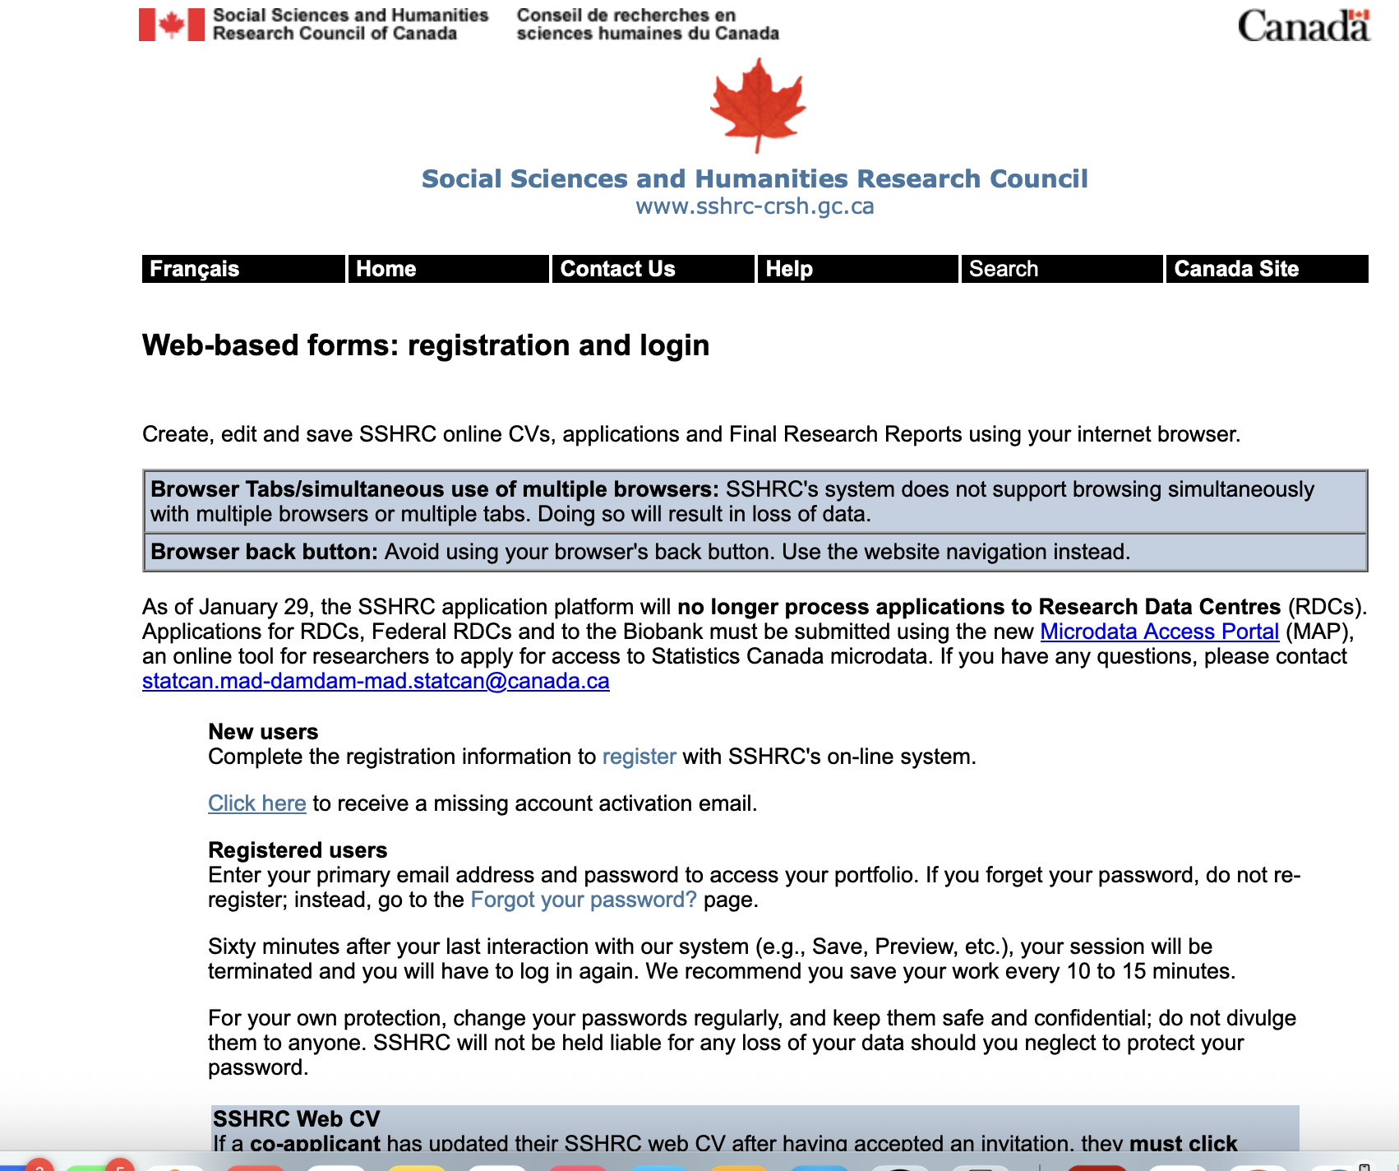
Online Portal
SSHRC Application
CV

Slide 8
Selection Criteria
50% -Research ability and potential
50% -Relevant experiences and achievements obtained within and beyond academia

Slide 9
Selection Criteria – Research Ability and Potential
Quality of research proposal
    specific, focused, and feasible research question(s) and objective(s)
    clear description of the proposed methodology
    significance and expected contributions to research
Relevant training, such as academic training, lived experience and traditional teachings
Research experience and achievements relative to the applicant’s stage of study, lived experience and knowledge systems

Slide 10
Selection Criteria – Research Ability and Potential
Quality of contributions and extent to which they advance the field of research. Contributions may include: publications, patents, reports, posters, abstracts, monographs, presentations, creative outputs, knowledge translation outputs, community products, etc.
Demonstration of sound judgment and ability to think critically
Demonstration of responsible and ethical research conduct, including honest and thoughtful inquiry, rigorous analysis, commitment to safety and to the dissemination of research results, and adherence to the use of professional standards
Enthusiasm for research, originality, initiative, autonomy, relevant community involvement and outreach
The ability or potential to communicate theoretical, technical and/or scientific concepts clearly and logically in written and oral formats

Slide 11
Selection Criteria –Relevant Experience & Achievements
Scholarships, awards and distinctions (amount, duration and prestige)
Academic record, such as:
  Transcripts
  Duration of previous studies
  Program requirements and courses pursued
  Course load
  Relative standing in program (if available)

Slide 12
Selection Criteria –Relevant Experience & Achievements
Professional, academic, and extracurricular activities as well as collaborations with supervisors, colleagues, peers, students and members of the community, such as:
          teaching, mentoring, supervising and/or coaching
          managing projects
          participating in science and/or research promotion
          community outreach, volunteer work and/or civic engagement
          chairing committees and/or organizing conferences and meetings
          participating in departmental or institutional organizations, associations, societies and/or clubs

Slide 13
Reference letters: Who, When, and How
Academics (professor/supervisor/advisor) are best but it can depend on your project
Someone who knows you well and can comment on your academic skills, your research abilities/potential, and your communication/leadership skills.
Someone who is enthusiastic about you and your scholarly aptitude
Request as early as possible, in person or by email. Do not request initially through a portal, ask via another means first!
Provide submission details (do they need to complete a specific form, is it by email, etc.), competition details, deadline, etc.
Provide a copy of your application, proposal, papers (if any), current CV, unofficial transcript(s), etc.
Highlight your academic and non-academic activities relevant to this award.
Notes:
Help them help you by giving them the info they need to write an outstanding letter.

Slide 14
Reference Letters
Referee assessments must be done in the SSHRC On-line System
Contact your referees early, and be very clear about what you need from them –reminder the internal Western deadline is September 22nd so letters should be uploaded day before
Enter the family name, given name and email address of each referee. These fields will be used to autopopulate the referee form.
After the data are saved, the system will automatically generate an email to each person, inviting them to complete a Letter of Appraisal form.
It is your responsibility to ensure that each invited person completes and verifies the form before the application deadline.
Notes:
Really? They can set a deadline?

Slide 15
Research Proposal – 2 Pages
Your application will be reviewed by members of a multidisciplinary selection committee, not all of whom will be familiar with your area of research.
Provide an outline of your research project, including:
    The research question(s)
    Context
    Objectives
    Methodology
    Significance
    Expected contributions to advancing knowledge

Slide 16
The Proposal: Short but sweet
Get examples of successful proposals
Create any required headings first
Use language appropriate to a non-specialist audience; avoid jargon, abbreviations, acronyms
Have a clear title
Begin with a powerful statement and clearly identify the scholarly gap ASAP.
Discuss your own work if relevant!
Must be sufficiently detailed even if your thesis is TBD (you may change research direction during the course of the award).
Keep it feasible
Be enthusiastic but don’t overstate/overreach
Leave enough time to get feedback from your supervisor!
Spelling, punctuation, writing quality all matter

Slide 17
EDIDA in Research
When writing your Research Proposal:
• If it is appropriate and true, indicate how your research addresses or examines elements of equity, diversity and inclusiveness
This could be in the proposal topic, recruitment of participants, dissemination of results
Are there possible outcomes from your research that can support EDIDA?

Slide 18
Diversity Considerations in Research Design Module
Mandatory Module
After you’ve answered “yes” or “no” to the question “Do diversity considerations apply to your proposed research design?”, indicate in the text box how diversity considerations are applicable or not to your research proposal (maximum 1,700 characters).
Before completing this module, read the Guide to including diversity considerations in research design for doctoral and postdoctoral award applicants.

Slide 19
Research contributions, relevant experience and activities
Maximum two pages
Broken into two sections:
          Research Contributions
          Applicant's Statement

Slide 20
Research Contributions
Given the page limits, be selective and summarize information where appropriate.
Refereed contributions (single or co-authored peer-reviewed publications)
Other refereed contributions (papers presented at conferences, trade journals)
Non-refereed contributions (book reviews, policy papers, posters, public lectures)
Forthcoming contributions (include status – i.e. "submitted", "under revision", etc.)
Creative outputs (exhibitions, performances, film, audio recordings, etc.)
Although it is possible to list research contributions, SSHRC recognizes that some applicants might not yet have publications or other research contributions to list.
Notes:
Label these clearly so reviewers can tell what your contributions are.

Slide 21
Applicant's Statement
In this section, group your comments under the following headings:
Relevant experience: Describe the research abilities you have gained through your past research experience, including special projects, honours/master’s thesis, co-op USRI, etc. If you have relevant work experience, discuss its relevance to your proposed area of study/research and any benefits you gained from it.
This section can also be used to describe any training relevant to your proposed research, such as knowledge gained through lived experience and traditional teachings.

Slide 22
Applicant's Statement
Relevant activities: Describe your participation in relevant professional, academic and extracurricular activities, as well as collaborations with supervisors, colleagues, peers, students and community members, such as:
    teaching, mentoring, supervising and/or coaching;
    managing projects; participating in science and/or research promotion;
    community outreach, volunteer work and/or civic engagement;
    chairing committees and/or organizing conferences and meetings;
    and participating in departmental or institutional organizations, associations, societies and/or clubs.

Slide 23
Bibliography and Citations – 5 pages
A bibliography for your proposed research (do not include endnotes)
Bibliographic details for all citations included in your program of study (ensure that these are clear and complete, to allow reviewers to locate the sources easily)
Demonstrate that you are aware of foundational works in your area of research and study, while also up to date with current works
Style of reference is open, however ensure citation style is consistent

Slide 24
Allowable Inclusions – Max 1 page (if applicable)
• Explain gaps in your study, research, or professional life due to health, parental, career, family, or personal crisis
• Provide the relevant facts, and note how you have since moved forward
• Provide dates of any delays or interruptions
• Be “matter of fact.” This is an explanation; do not include overly personal information
• Reviewers will be asked to take allowable inclusions into consideration and so they will see this section
Notes:
You may not even need to complete this section.

Slide 25
Presentation Standards – All Attachments
All attachments MUST adhere to SSHRC’s general presentation standards:
    Body text in a minimum 12 pt Times New Roman font
    Single-spaced, with no more than 6 lines of type per inch
    All margins set at a minimum of 3/4 “ or 1.87 cm
Pay attention to page limits, and electronic file attachment specifications noted in all relevant sections of the application

Slide 26
Transcripts
Up to date (meaning complete) official transcripts of all undergraduate and graduate studies must be uploaded including transcript that shows your current registration status –even if you are new and no grades are recorded yet
    Proves your months of study
    Proves your currents status
    Proves degrees completed
Transcripts in language other than English or French must be translated and a certified copy of the translation provided
You upload your transcripts; scan all transcripts into one PDF document, with one copy of the legend per transcript included
If you’ve taken a Leave of Absence or studied part-time, it should show on your transcript. You need an official letter to confirm PT study or leaves. Speak to the Registrar's Office if you need this.

Slide 27
Final Submission in Portal
Applicants must click "Preview" and "Verify" for each page of their application as they complete it, and well in advance of the deadline (internal Western deadline of noon on September 22).
SSHRC’s online system will not accept applications that are incomplete (i.e., that contain unverified sections). If applicants make changes to a page, they must click "Verify" again for that page in order to confirm that SSHRC’s online system will accept the new information when they submit their application. Note that validation only confirms that mandatory sections (including uploads and letters) have been completed; it does not validate application content.
It is the applicant’s responsibility to verify content and ensure all required application components (CV, two letters of appraisal, and all PDF attachments) have been submitted. All attachments, including letters of appraisal, must be provided in English or French only.
Late submissions will not be accepted.

Slide 28
Other Support
Your Supervisor!!!!!
Faculty of Social Science
  Drop-in sessions for Q & A and appointments for proposal development
  Wednesdays: July 30th and August 6, 13, 20th from 12:00-1:00 PM (Registration and zoom link to follow)
  Proposal feedback – due dates: August 10th and August 17th
Western’s Writing Support Centre
  3 virtual workshops in July, August, October on Tri-Agency scholarships (focused on proposal writing)
  Email announcement to be sent to students soon
Agency Support
  Virtual, agency-specific Q&A sessions
  SGPS’s CGRS D webpage will be updated when they know more

Slide 29
After you submit your application….
Take a deep breath, pat yourself on the back, enjoy the beverage/snack of your choice, and…….
Start thinking about next year!
  What can you do to build your CV to be an even stronger applicant next time, if you need to try, try again?
  Conference presentations
  Manuscripts
  Etc., etc.

Slide 30

Questions?

